Slide 1
Go Language Sharing
Bowen Chen
2016-12-23

Slide 2
Go History
Go Variables And Types
Go Concurrency
Go Methods And Interfaces
Appendix

Slide 3
Go History
Go originated as an experiment by Google engineers Robert Griesemer, Rob Pike, and Ken Thompson to design a new programming language that would resolve common criticisms of other languages while maintaining their positive characteristics. The new language was to:
be statically typed, scalable to large systems (as Java and C++).
be productive and readable, without too many mandatory keywords and repetition.
not require tooling, but support it well.
support networking and multiprocessing.
Go was announced in November 2009.
Go 1.0 was released in March 2012.
Go 1.5 was released in August 2015.
Go 1.7 was released in this year.

Slide 4
package main
import "fmt"
func main() {
fmt.Println("Hello, 世界")
}

Slide 5
import (
"fmt"
"io/ioutil"
"net/http"
"os"
)
func main() {
for _, url := range os.Args[1:] {
resp, err := http.Get(url)
if err != nil {
fmt.Fprintf(os.Stderr, "fetch: %v\n", err)
os.Exit(1)
}
b, err := ioutil.ReadAll(resp.Body)
resp.Body.Close()
if err != nil {
fmt.Fprintf(os.Stderr, "fetch: reading %s: %v\n", url, err)
os.Exit(1)
}
fmt.Printf("%s", b)
}
}

Slide 6
import (
"fmt"
"log"
"net/http"
)
func main() {
http.HandleFunc("/", handler) // each request calls handler
log.Fatal(http.ListenAndServe("localhost:8000", nil))
}
// handler echoes the Path component of the requested URL.
func handler(w http.ResponseWriter, r *http.Request) {
fmt.Fprintf(w, "URL.Path = %q\n", r.URL.Path)
}

Slide 7
Go Variables And Types
var a int
a = 3
var a = 3
a := 3
x := 1
p := &x
fmt.Println(*p) // "1"
*p = 2
fmt.Println(*p) // "2"
s := "hello, world"
fmt.Println(len(s))
fmt.Println(s[0], s[7]) // "104, 119" ('h' and 'w')
fmt.Println(s[0:5] // "hello"
array
var a [3] int
fmt.Println(a[0])
slices
var x []int
x = append(x, 1)
x = append(x, 2, 3)
fmt.Println(x) // "[1, 2, 3]"
maps
var ages map[string]int
fmt.Println(ages == nil) // "true"
ages = make(map[string]int)
ages["bowen"] = 24

Slide 8
import "fmt"
type Point struct{
X, Y int
}
type Circle struct {
Point
Radius int
}
type Wheel struct {
Circle
Spokes int
}
func main() {
var w Wheel
w = Wheel{Circle{Point{8, 8}, 5}, 20}
w = Wheel{
Circle: Circle{
Point: Point{X: 8, Y: 8},
Radius: 5,
},
Spokes: 20,
}
fmt.Printf("%#v\n", w)
// Output:
// Wheel{Circle:Circle{Point:Point{X:8, Y:8}, Radius:5}, Spokes:20}
w.X = 42
fmt.Printf("%#v\n", w)
// Output:
// Wheel{Circle:Circle{Point:Point{X:42, Y:8}, Radius:5}, Spokes:20}
}

Slide 9
Go Concurrency
Two stlyes of concurrent programming
CSP(communicating sequential process)
Ordinary Methods(such as Mutual Exclusion)

Slide 10
Goroutines And Channels
In Go, each concurrently executing activity is called a goroutine.
f() // call f(); wait for is to return
go f() // create a new goroutine that calls f(); don't wait

Slide 11
func main() {
go spinner(100 * time.Millisecond)
const n = 45
fibN := fib(n)
fmt.Printf("\rFibonacci(%d) = %d\n", n, fibN)
}
func spinner(delay time.Duration) {
for {
for _, r := range `-\|/` {
fmt.Printf("\r%c", r)
time.Sleep(delay)
}
}
}
func fib(x int) int {
if x < 2 {
return x
}
return fib(x-1) + fib(x-2)
}

Slide 12
A channel is a communication mechanism that lets one goroutine send values to another goroutine.
ch := make(chan int) // ch has type 'chan int'
ch := make(chan int, 3) // ch has type 'chan int'
ch <- x // a send statement
x = <-ch // a receive expression in an assignment
<-ch
close(ch)
communication causes synchronize

Slide 13
Concurrency Samples
func f(left, right chan int) {
left <- 1 + <-right
}
func main() {
const n = 10000
leftmost := make(chan int)
right := leftmost
left := leftmost
for i := 0; i < n; i++ {
right = make(chan int)
go f(left, right)
left = right
}
go func(c chan int) { c <- 1 }(right)
fmt.Println(<-leftmost)
}

Slide 14
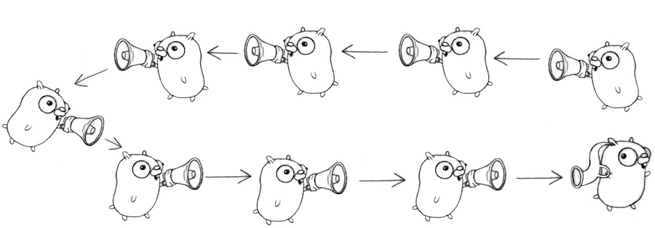

Slide 15
func counter(out chan int) {
for x := 0; x <= 100; x++ {
out <- x
}
close(out)
}
func squarer(out chan int, in chan int) {
for v := range in {
out <- v * v
}
close(out)
}
func printer(in chan int) {
for v := range in {
fmt.Println(v)
}
}
func main() {
naturials := make(chan int)
squares := make(chan int)
go counter(naturials)
go squarer(squares, naturials)
printer(squares)
}

Slide 16
Google Search: A fake framework
We can simulate the search function, much as we simulated conversation before.
var (
Web = fakeSearch("web")
Image = fakeSearch("image")
Video = fakeSearch("video")
)
type Result string
type Search func(query string) Result
func fakeSearch(kind string) Search {
return func(query string) Result {
time.Sleep(time.Duration(rand.Intn(100)) * time.Millisecond)
return Result(fmt.Sprintf("%s result for %q\n", kind, query))
}
}

Slide 17
func First(query string, replicas ...Search) Result {
c := make(chan Result)
searchReplica := func(i int) { c <- replicas[i](query) }
for i := range replicas {
go searchReplica(i)
}
return <-c
}
func main() {
rand.Seed(time.Now().UnixNano())
start := time.Now()
result := First("golang",
fakeSearch("replica 1"),
fakeSearch("replica 2"))
elapsed := time.Since(start)
fmt.Println(result)
fmt.Println(elapsed)
}

Slide 18
Go Methods And Interfaces
Object is simply a value or variable that has methods, and a method is a function associated with a particular type.
func Distance(p, q Point) float64 {
return math.Hypot(q.X-p.X, q.Y-p.Y)
}
func (p Point) Distance(q Point) float64 {
return math.Hypot(q.X-p.X, q.Y-p.Y)
}

Slide 19
An interface is an abstract type, it reveals only some of their methods.It specifies a set of methods that a concrete type must possess to be considered an instance of that interface.
type Writer interface {
Writer(p []byte) (n int, err error)
}
type Reader interface {
Read(p []byte) (n int, err error)
}
type Closer interface {
Close() error
}

Slide 20
Appendix
https://golang.org
https://gobyexample.com
https://github.com/astaxie/build-web-application-with-golang
https://github.com/qyuhen/book
https://talks.golang.org
The Go Programming Language [Book]
https://github.com/adonovan/gopl.io
http://docs.ruanjiadeng.com/gopl-zh/

